Slide 1
Personality
What are you like?

Slide 3
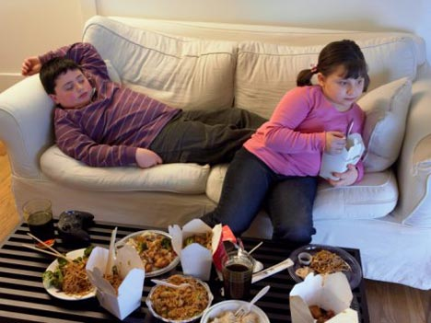
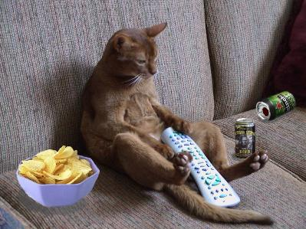
COUCH POTATO

Slide 4

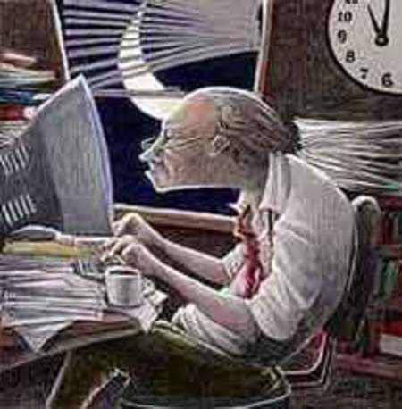
WORKAHOLIC

Slide 5
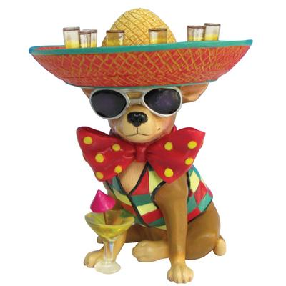
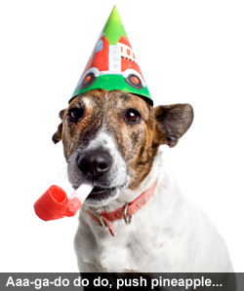
PARTY ANIMAL
?
?

Slide 6
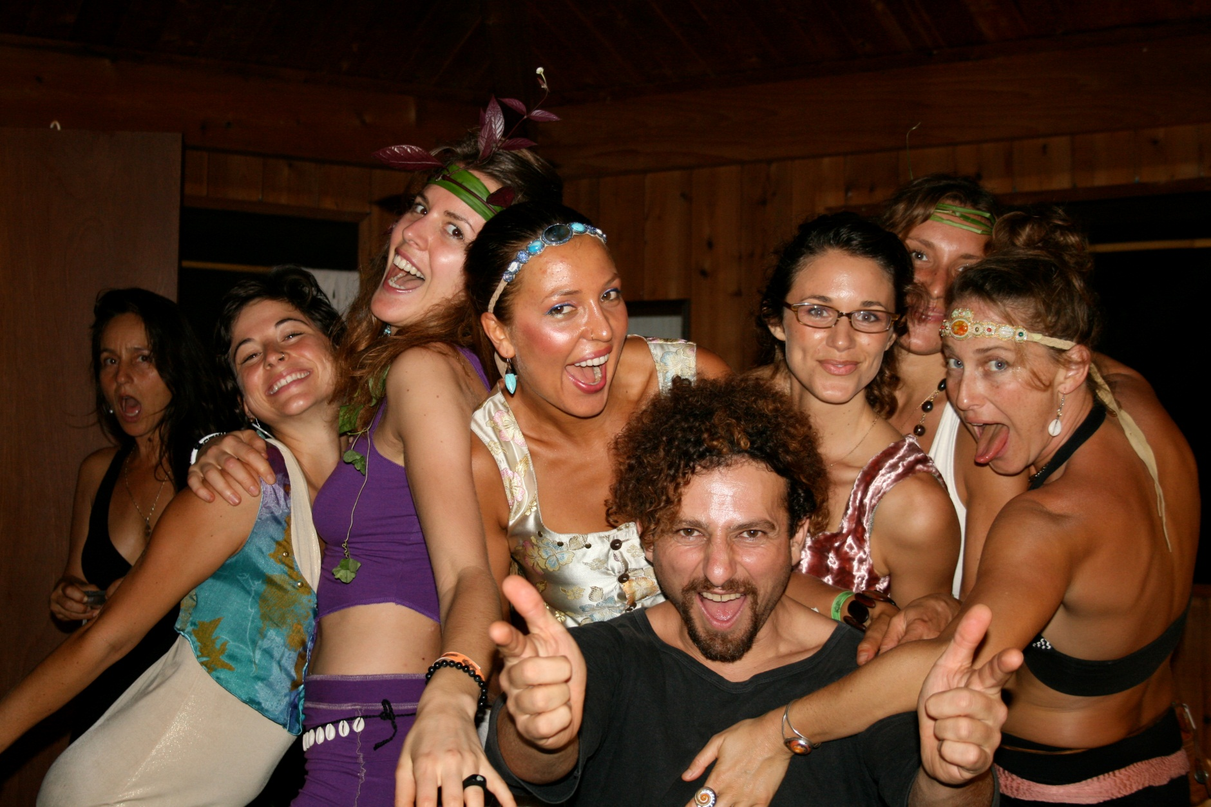
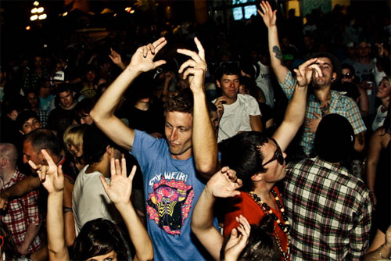
PARTY ANIMALS

Slide 7

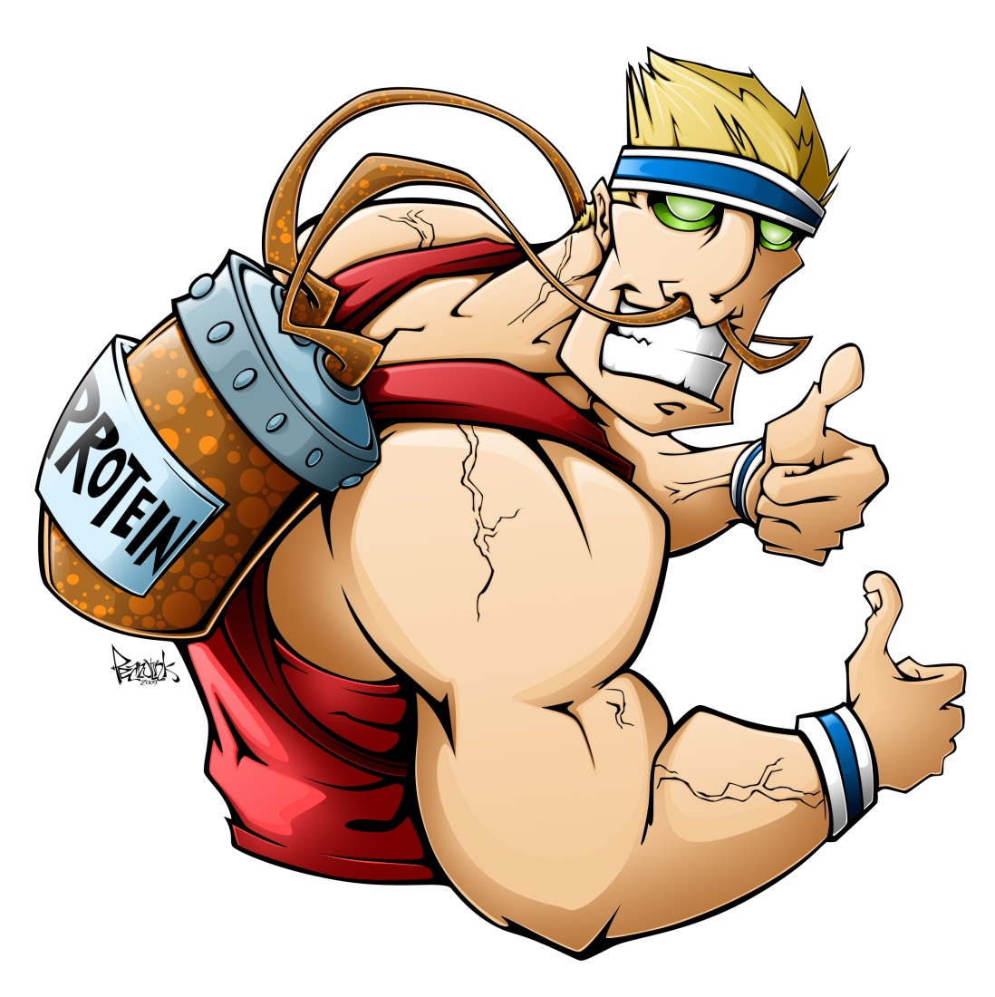
HEALTH NUT

Slide 8

COUCH POTATO
PARTY ANIMALS
HEALTH NUT
WORKAHOLIC

Slide 9
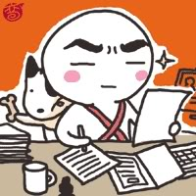
What is he like?
He is serious and hardworking

Slide 10
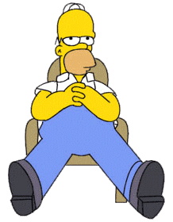
What is he like?
He is lazy.
He is not hardworking

Slide 11
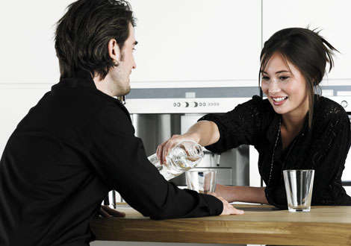
What is she like?
She is outgoing because she is very friendly and extrovert.
She is not shy

Slide 12

What is he like?
He is somewhat shy.
He is not outgoing because he is very timid

Slide 13
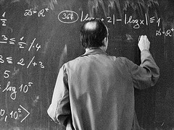
What is he like?
He is very smart.
He is very intelligent

Slide 14
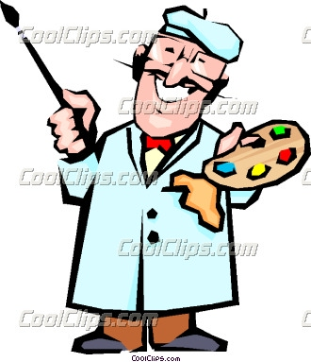
What is he like?
He is creative because he likes painting, and he has a good imagination.

Slide 15
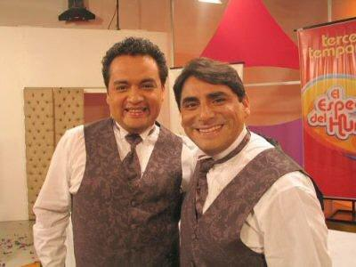
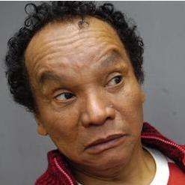
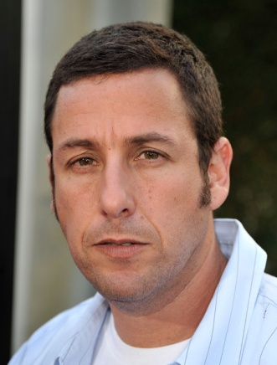
What are they like?
They are funny.
People always laugh at their jokes.

